Slide 1
CSE 575: Statistical Machine Learning (2023 Spring)
The Power of Collaboration: Machine Learning for Team Performance Optimization
Team: 16

Slide 2


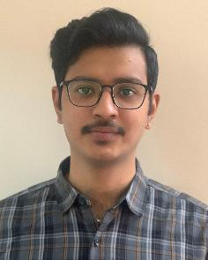



Team Composition
Deekshith Reddy Yeruva (1225545620)
Aasish Tammana (1225545568)
Shilpitha Gandla (1224631798)
Sai Charan Raghupatruni (1226175225)
Sangeetha Ramaswami (1224264691)
Praveen Sama (1226337608)
Team: 16

Slide 3
Introduction
Our study is inspired by the articles "Replacing the Irreplaceable: Fast Algorithms for Team Member Recommendation" by Liangyue Li et al. and “Finding a Team of Experts in Social Networks” by Theodoros Lappas et al.
Our ultimate goal is to create a replacement system that offers the best team configurations by maximizing team strengths and minimizing shortcomings using Machine Learning approaches.
This approach can assist coaches and team managers in making well-informed judgments about their team's make-up and tactics.
Additionally, it can be applied to substitute injured or sick athletes and to select employees suited for specific jobs in business teams.
Team: 16

Slide 4
Problem statement
Optimize team performance by developing a recommendation system for coaches and team managers to create the best team configurations based on strengths and weaknesses discovered using machine learning techniques on NBA statistics data.
Team: 16

Slide 5
Motivation for this project
The efficiency and efficacy of the team working on a project are crucial factors for the performance on any task.
The abrupt absence of a crucial team member due to unforeseeable events like illness, resignation, or termination, however, can have an impact on even the greatest team known.
Finding a competent substitute who can execute at the same level as the departing team member is crucial in such circumstances to prevent project delays or disruptions.
Finding a key team member's replacement can be difficult for project managers and team leaders because it is frequently expensive, time-consuming, and subjective.
As a result, there is a need for an effective algorithm that can quickly and economically suggest viable replacements for important team members.
Team: 16

Slide 6
Literature Survey
Liangyue Li, Hanghang Tong, Nan Cao, Kate Ehrlich, Yu-Ru Lin and Norbou Buchler:
Replacing the Irreplaceable: Fast Algorithms for Team Member Recommendation
Background:
In the fields of social network analysis and machine learning, there has been substantial research on the issue of team member recommendation.
In order to find suitable replacements for a critical team member, current approaches for team member recommendation often rely on a variety of elements including abilities, experience, and social network connections.
However, these approaches frequently have a number of drawbacks, including low precision, a high level of computing complexity, and constrained scalability.
The previous works mainly focus on team formation from scratch [2][3][5] whereas this work aims to find a new team member , so that the new team resembles the original team as much as possible.
As a result, a quick and precise algorithm is required to get around these obstacles and offer a workable solution to the team member suggestion issue.
Team: 16

Slide 7
Literature Survey
Liangyue Li, Hanghang Tong, Nan Cao, Kate Ehrlich, Yu-Ru Lin and Norbou Buchler:
Replacing the Irreplaceable: Fast Algorithms for Team Member Recommendation.
Proposed Algorithm: The paper's suggested algorithm incorporates three crucial elements.
Skill-based matching: The algorithm compares the skill vectors of possible replacements and the remaining team members using a similarity measure based on similarity (Ex: Voronoi Diagrams). The best replacement for the departing team member is found using the similarity measure
Social network analysis: The algorithm makes use of the team's network structure to discover candidates for replacements whose connections to the team members maximize their chances of integrating successfully
Machine learning-based model: The authors used graph kernels and proposed effective and scalable algorithms for team member replacement
Team: 16

Slide 8
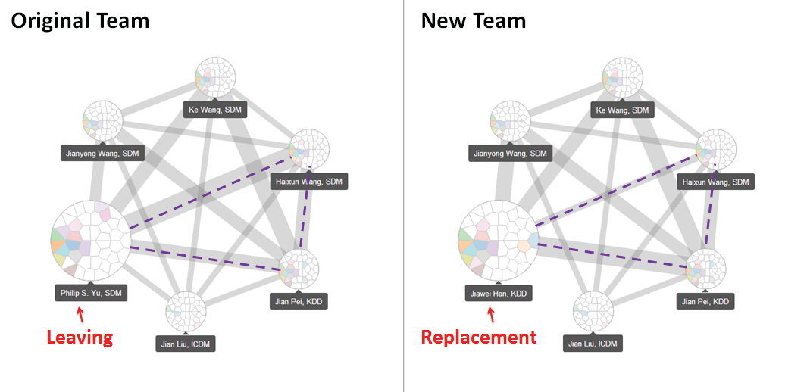
Literature Survey
Liangyue Li, Hanghang Tong, Nan Cao, Kate Ehrlich, Yu-Ru Lin and Norbou Buchler:
Replacing the Irreplaceable: Fast Algorithms for Team Member Recommendation.
Figure 1: Team Graph before and after Replacement [1]
Team: 16

Slide 9
Literature Survey
Liangyue Li, Hanghang Tong, Nan Cao, Kate Ehrlich, Yu-Ru Lin and Norbou Buchler:
Replacing the Irreplaceable: Fast Algorithms for Team Member Recommendation.
Solutions:
To implement the proposed algorithm in the paper a similarity measure known as team context aware similarity measure is utilized
This measure captures both skill matching and structural matching as well as the interaction between both these methods
Mathematically graph kernel defined on the current and new teams can be used as a tool for team context aware similarity
Team: 16

Slide 10
Literature Survey
Liangyue Li, Hanghang Tong, Nan Cao, Kate Ehrlich, Yu-Ru Lin and Norbou Buchler:
Replacing the Irreplaceable: Fast Algorithms for Team Member Recommendation.
Graph Kernels
The idea behind graph kernels is that the similarity of the sub-graphs between the two input graphs are compared and then aggregated to give the overall similarity between the two graphs.
Reason for choosing Graph Kernels for team context aware similarity
Each subgraph in a given team reflect a specific skill among a sub-group of team members
By comparing the similarity between two subgraphs it’s possible to measure the capability of the new team member to perform that particular sub-task
By aggregating these similarity for each task the overall capability of new team member can be computed
In this paper mainly random walk based graph kernel approach is utilized
Team: 16

Slide 11
Literature Survey
Liangyue Li, Hanghang Tong, Nan Cao, Kate Ehrlich, Yu-Ru Lin and Norbou Buchler:
Replacing the Irreplaceable: Fast Algorithms for Team Member Recommendation.
Random Walk-based Graph Kernels
Random Walks: A random walk is a sequence of nodes traversed in a graph, where each node is chosen uniformly at random from its neighbors. Random walks capture the local structure and connectivity of a graph.
This graph kernel incorporates the interactions between individual skills and team structure in a unified framework. We compute the similarity between two graphs by counting the common random walks they share.
These algorithms leverage effective pruning strategies to reduce the computational cost and explore the smoothness between the existing and the new team structures for faster computations.
Team: 16

Slide 12



Literature Survey
Liangyue Li, Hanghang Tong, Nan Cao, Kate Ehrlich, Yu-Ru Lin and Norbou Buchler:
Replacing the Irreplaceable: Fast Algorithms for Team Member Recommendation.
Random Walk based graph kernel
Given two labelled graphs where i=1,2
Random walk based graph kernel between them can be computed [6] using following equation:
, referred as TeamRep-Basic
Here: is the weight matrix of two graph’s matrix direct product, c is decay factor, y and x are starting and stopping vectors to indicate weights of different nodes and is a diagonal matrix
Team: 16

Slide 13
Literature Survey
Liangyue Li, Hanghang Tong, Nan Cao, Kate Ehrlich, Yu-Ru Lin and Norbou Buchler:
Replacing the Irreplaceable: Fast Algorithms for Team Member Recommendation.
Computational challenges in TeamRep-Basic method:
The method TeamRep-Basic is computationally intensive as:
Many random walk graph kernels have to be computed
Each computation would be expensive especially when team size is large
The time complexity for this algorithm is O(nt⁶)
Methods to overcome the above challenges:
Scale-up: Candidate filtering by using pruning strategy - Filter out candidates who do not have any connections with rest of team members
Speedup Graph kernel: Computing top r approximation
Team: 16

Slide 14
Literature Survey
Liangyue Li, Hanghang Tong, Nan Cao, Kate Ehrlich, Yu-Ru Lin and Norbou Buchler:
Replacing the Irreplaceable: Fast Algorithms for Team Member Recommendation.
The TeamRep-Fast-Exact and TeamRep-Fast-Approx algorithms are two fast algorithms proposed by the authors to efficiently compute the random walk-based graph kernel for team member recommendation.
TeamRep-Fast-Exact provides an exact computation of the random walk-based graph kernel, while TeamRep-Fast-Approx offers a faster runtime with a small approximation error. The choice between the two algorithms depends on the specific requirements and constraints of the team member recommendation task, in terms of computational efficiency and accuracy.
TeamRep-Fast-Exact leverages effective pruning strategies to reduce the computational cost of computing the kernel, such as pruning irrelevant nodes and edges in the graph, and avoids redundant computations.
TeamRep-Fast-Approx works at the cost of a small approximation error. It uses a sampling-based approach to approximate the kernel computation, by randomly selecting a subset of random walks instead of considering all possible walks.
Team: 16

Slide 15
Literature Survey
Liangyue Li, Hanghang Tong, Nan Cao, Kate Ehrlich, Yu-Ru Lin and Norbou Buchler:
Replacing the Irreplaceable: Fast Algorithms for Team Member Recommendation.
Evaluation:
The authors conducted comprehensive experiments to evaluate the effectiveness and efficiency of their proposed algorithms for team member recommendation.
Evaluation was based on the following:
Precision, recall, and F1-score. Precision measures the accuracy of team member recommendations, recall measures the ability to identify all relevant candidates, and F1-score balances the trade-off between precision and recall
The authors compared their proposed algorithms with several baseline methods, including traditional graph kernel methods that consider only skill matching or structure matching independently. The baselines were selected to represent different approaches and provide meaningful comparisons.
Team: 16

Slide 16
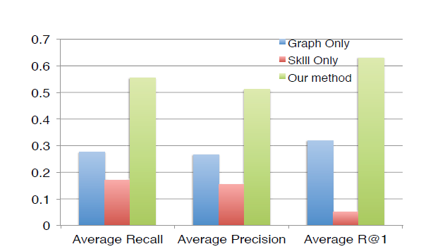
Literature Survey
Liangyue Li, Hanghang Tong, Nan Cao, Kate Ehrlich, Yu-Ru Lin and Norbou Buchler:
Replacing the Irreplaceable: Fast Algorithms for Team Member Recommendation.
Figure 2: The average recall, average precision and R@1 of the three comparison methods. Higher is better[1]
1]
Team: 16

Slide 17
Literature Survey
Liangyue Li, Hanghang Tong, Nan Cao, Kate Ehrlich, Yu-Ru Lin and Norbou Buchler:
Replacing the Irreplaceable: Fast Algorithms for Team Member Recommendation.
Experimental Results:
The studies' findings demonstrated that the suggested algorithm performed better than the alternatives in terms of accuracy and speed. In particular, the authors discovered that:
The proposed algorithms outperformed the alternative choices in terms of both precision and recall, demonstrating the superiority of their approach in identifying suitable team member replacements.
Their algorithms achieved a good balance between precision and recall, indicating a well-rounded performance.
Their approach was resilient to parameter changes and consistently performed well when varying different parameters, such as the threshold for pruning strategies.
Team: 16

Slide 18
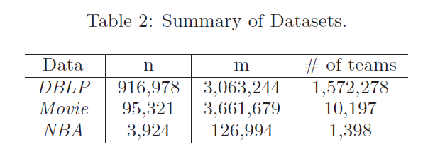
Dataset
The three different datasets utilized in the paper to test the TeamRep-Fast-Exact and TeamRep-Approx algorithms are:
Figure 8: Dataset [1]
Team: 16

Slide 19
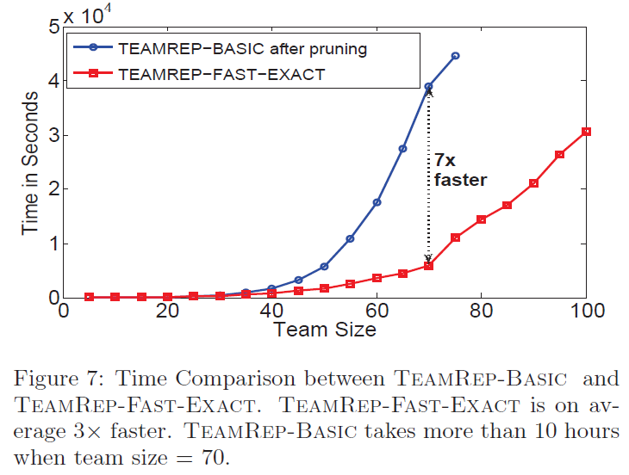
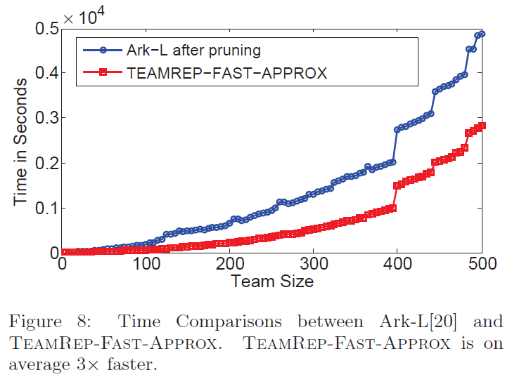
Performance Evaluation
DBLP dataset provides bibliographic information about computer science journals and proceedings
This data is used to build co-authorship network
Various conferences are used to reflect author’s skills
The results outlined in the paper for DBLP dataset are as follows:
Figure 9: Time Comparison of TEAMREP-BASIC and TEAMREP-EXACT [1]
Figure 10: Time Comparison of Ark-L [10] and TEAMREP-APPROX [1]

Slide 20
Literature Survey
Theodoros Lappas, Kun Liu and Evimaria Terzi: Finding a team of experts in social networks
Background :
The success of a project depends not only on the expertise of the people who are involved, but also on how effectively they collaborate, communicate and work together as a team.
The existence of a social network between individuals is quite common in real scenarios. In a company, the network may capture the hierarchical organization of the employees.
In a research community, the network captures previous successful collaborations among scientists

Slide 21
Literature Survey
Theodoros Lappas, Kun Liu and Evimaria Terzi: Finding a team of experts in social networks
TEAM FORMATION PROBLEM:
The problem is modeled into a weighted and undirected graph G (X , E) consisting of candidates as nodes where X : pool of candidates, The weight on an edge represent the communication cost between candidates at the ends of the edge.
The goal is to find a subgraph in G that only involves X’ (subset of X) that satisfies the required skill set for a given task T with a minimized communication cost.
Team: 16

Slide 22
Literature Survey
Theodoros Lappas, Kun Liu and Evimaria Terzi: Finding a team of experts in social networks
PRELIMINARIES
We instantiate the following :
X ={ 1, 2, 3, . . . , n}.
Xi = set of skills of candidate i.
T = set of skills required to complete the task.
S(a) = set of individuals in X that have the skill “a”

Slide 23
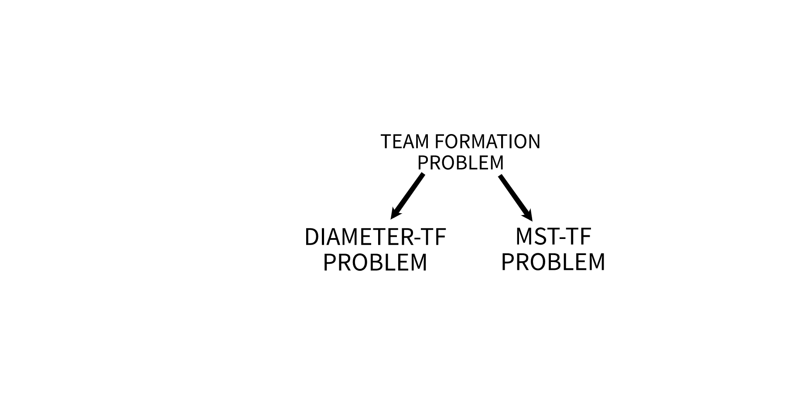
Literature Survey
Theodoros Lappas, Kun Liu and Evimaria Terzi: Finding a team of experts in social networks
The TEAM FORMATION Problem is NP-Complete [9] . Therefore it is tackled by reducing to known NP-Complete problems. They are Multiple Choice Cover (MCC) problem [7] and Group Steiner Tree (GST) Problem [8]. These 2 approaches to the problem are given below :
Diameter-TF Problem :
Diameter (R): Given graph G (X , E) and a set of individuals X 0 ⊆ X , we define the diameter communication cost of X’ , denoted by Cc-R (X’), to be the diameter of the subgraph G [X’]. Recall that the diameter of a graph is the largest shortest path between any two nodes in the graph.
Figure 3: Different Approaches to TEAM FORMATION Problem

Slide 24
Literature Survey
Theodoros Lappas, Kun Liu and Evimaria Terzi: Finding a team of experts in social networks
The Diameter-TF problem is NP-complete.
Reduction from the Multiple-Choice Cover (Mcc) problem [8].
Instance :
V = {1, . . . , N}
N × N symmetric real matrix D with non negative entries
S = {S1, . . . , Sk} such that Si ⊆ V
Decision Version of MCC Problem :
Given constant K, the decision version of the Mcc problem asks whether there exists V’ ⊆ V such that for every i ∈ {1, . . . , k},
|V’ ∩ Si| > 0 and max(u,v)∈V’×V’ D(u, v) ≤ K

Slide 25
Literature Survey
Theodoros Lappas, Kun Liu and Evimaria Terzi: Finding a team of experts in social networks
Reduction of Diameter-TF problem to Decision version of MCC Problem
for every set Si in the Mcc problem we create a skill ai.
The task T to be performed requires all the k skills. That is, T = {a1, . . . , ak}.
every element v ∈ V of the Mcc instance, we create an individual iv with skills Xv = {ai | v ∈ Si}.

Slide 26
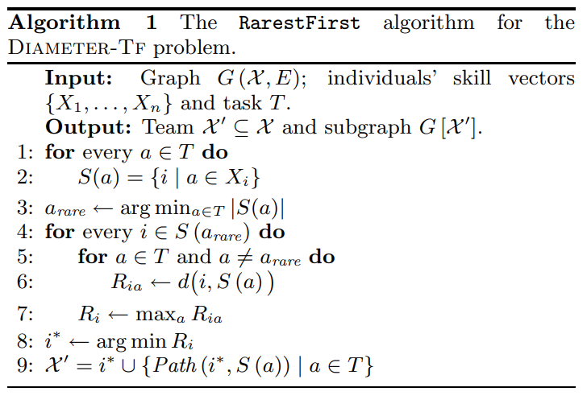
Literature Survey
Theodoros Lappas, Kun Liu and Evimaria Terzi: Finding a team of experts in social networks
Algorithm for Diameter-TF Problem :
Assuming all pair of shortest paths are computed, the time complexity of the algorithm is O(n²)
Figure 4: RarestFirst algorithm [2]

Slide 27
Literature Survey
Theodoros Lappas, Kun Liu and Evimaria Terzi: Finding a team of experts in social networks
MST-TF Problem :
Minimum Spanning Tree (Mst): Given graph G (X , E) and X’ ⊆ X we define the Mst communication cost of X’ , denoted by Cc-Mst (X’), to be the cost of the minimum spanning tree on the subgraph G [X’]. Recall that the cost of a spanning tree is simply the sum of the weights of its edges.

Slide 28
Literature Survey
Theodoros Lappas, Kun Liu and Evimaria Terzi: Finding a team of experts in social networks
The MST-TF problem is NP-complete.
Reduction from the Group Steiner Tree problem..
Instance :
Undirected Graph G (V, E)
Cost function c : E → R
k subsets of vertices {g1, . . . , gk} with gi ⊆ V, i ∈ {1, . . . , k}.
Decision Version of MCC Problem :
Given constant K, the decision version of the Gst problem asks whether there exists a subtree T (V’ , E’) of G (V, E) (i.e., V’⊆ V and E’ ⊆ E) such that |V’ ∩ gi| > 0 for every i ∈ {1, . . . , k} and cost (Summation over e ∈ E’ of c(e)) ≤ K.

Slide 29
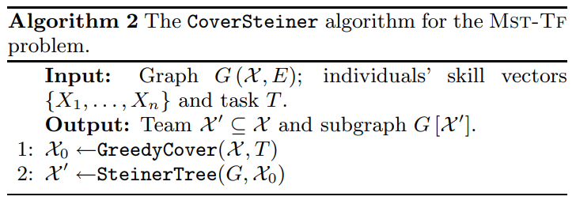
Literature Survey
Theodoros Lappas, Kun Liu and Evimaria Terzi: Finding a team of experts in social networks
Algorithm for MST-TF Problem :
Two algorithms for solving the MST-TF problem: the Cover Steiner and Enhanced Steiner algorithms. Both algorithms are motivated by the resemblance of MST-TF to Steiner tree problems.
Time Complexity of SteinerTree is O (|X0| × |E|). For GreedyCover, its O (mn). Therefore, for Cover Steiner its O(n³)
Figure 5: CoverSteiner algoithm [2]

Slide 30
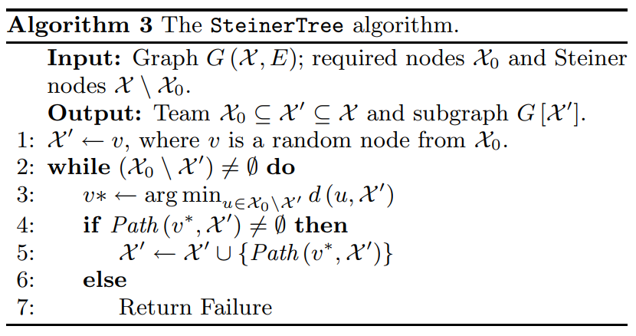
Literature Survey
Theodoros Lappas, Kun Liu and Evimaria Terzi: Finding a team of experts in social networks
Figure 6: SteinerTree algorithm [2]

Slide 31
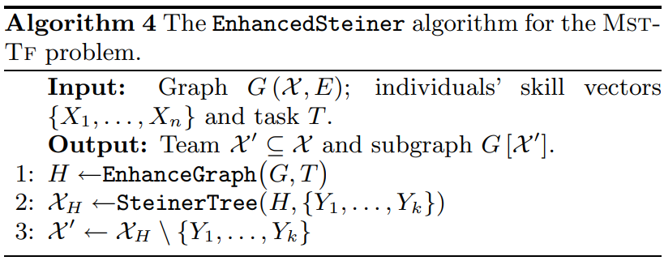
Literature Survey
Theodoros Lappas, Kun Liu and Evimaria Terzi: Finding a team of experts in social networks
EnhancedSteiner Algorithm:
Running time of the EnhancedSteiner algorithm is O (k × |E|)
Figure 7: EnhancedSteiner algorithm [2]

Slide 32
Dataset
snapshot of the DBLP data taken on April 12, 2006
Only entries of the snapshot that correspond to papers published in the areas of Database (DB), Data mining (DM), Artificial intelligence (AI) and Theory (T) conferences.
DB = {sigmod, vldb, icde, icdt, edbt, pods}, DM = {www, kdd, sdm, pkdd, icdm}, AI = {icml, ecml, colt, uai} and T = {soda, focs, stoc, stacs}.
TEAM FORMATION Problem for the Dataset
The set of skilled individuals Xdblp consists of the set of authors that have at least three papers in the DBLP dataset. The skillset Xi of each such author i consists of the set of terms that appear in at least two titles of papers in DBLP that he has co-authored
Xauthors = 5508, distinct skills = 1792
i, i’ are connected in the graph Gdblp (Xdblp, E) if they appear as co-authors in at least two papers in DBLP.

Slide 33
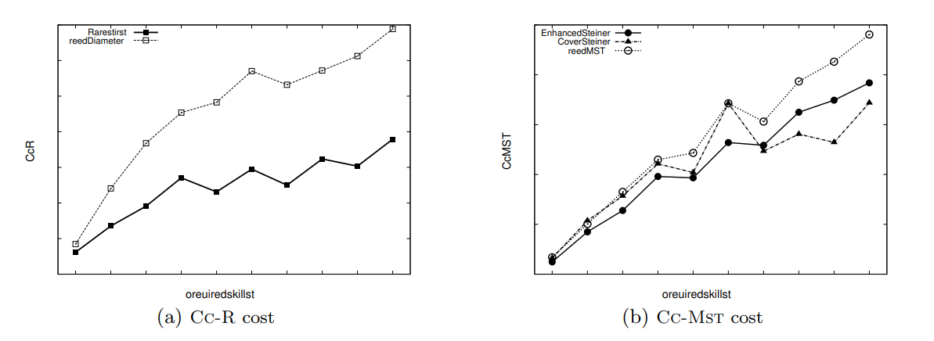
Literature Survey
Theodoros Lappas, Kun Liu and Evimaria Terzi: Finding a team of experts in social networks
Performance Evaluation :
Figure 8: Comparison of algorithms [2]

Slide 34
Comparison between models
 | Replacing the Irreplaceable | Finding a team of experts in Social networks
Proposed algorithms | TeamRep-Basic, TeamRep-Fast-Exact, TeamRep-Fast-Approx | Diameter-Tf and Mst-Tf
Real world Datasets | Uses data from the fields of computer science, movies, and sports, | Uses data from the DBLP database of academic publications.
Evaluation metrics | Uses both qualitative and quantitative evaluations to assess the system, Emphasizes the scalability of the proposed algorithms | Focuses primarily on quantitative evaluations of the different algorithms. Focuses on the communication cost, cardinality of the team, and connectivity of the team as key metrics for evaluating algorithm performance.
Goal | Aims to develop a system that can recommend replacements for unavailable team members | Aims to compare the performance of different algorithms for team formation in real-world scenarios.

Slide 35
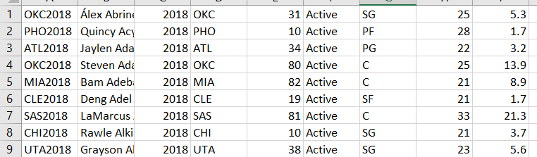
Implementation
Dataset:
For implementation, we took an NBA dataset from a website [4] . In the paper discussed earlier DBLP dataset was used.
From the NBA data available we generated a social network where the nodes are represented by players names and edge weights are the number of seasons they played together.
This data consists of NBA players stats from 1976 to 2019.
The datasheet contains the players name, team played,position,played,age,status of playing etc,Here is an example of data set.
Figure 9: Snapshot of the implemented dataset [4]

Slide 36
Implementation
Methodology used:
From the network obtained between players and number of skills set to five which include the position the player has played for (PG,SG,SF,PF,C), we use two algorithms from [1] to obtain a replacement for a player and suggest the top five candidates that could replace a player.
The two algorithms implemented are:
TeamRep -Fast-Exact Algorithm
TeamRep-Fast-Approx Algorithm
Team: 16

Slide 37
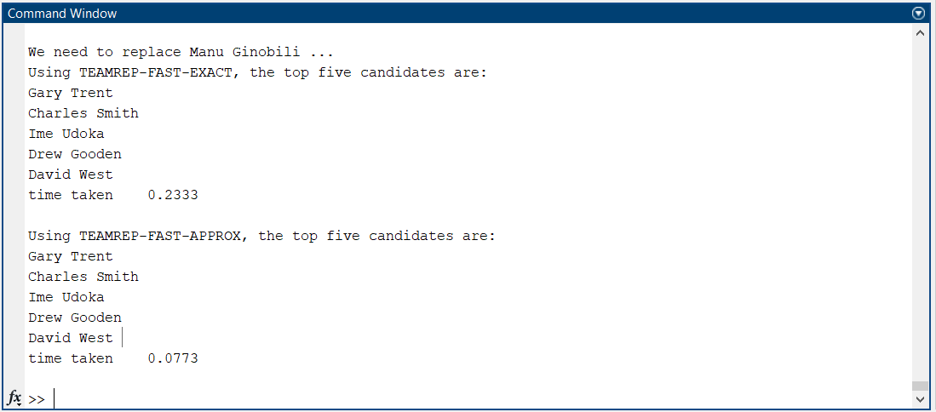
Results and Analysis
After implementing the TEAMREP-EXACT and TEAMREP-APPROX algorithms and taking
current team array = { Tim Duncan, Manu Ginóbili, Tony Parker, Micheal Finley, Matt Boner}
We gave our replacement ID as Manu Ginobili from the list of players. Here are the results after running 2 algorithms and suggesting the top 5 candidates that could replace him.
Figure 10: Output of the implemented algorithm [2]

Slide 38
Conclusion
In the paper “Finding a team of experts in Social Networks”, We minimized the communication cost among the members of the team. We explored two alternative formulations for the communication cost, which we believe are practical and intuitive. In a thorough experimental evaluation, we evaluated the performance of our algorithms, and compared them against reasonable baseline approaches.
In the paper “Replacing the Irreplaceable: Fast Algorithms for Team Member Recommendation” the graph kernel method was adopted to encode both skill matching and structural matching for team member replacement. The method was tested extensively on real world datasets and the method has given significantly better results in terms of both average precision (24% better) and recall (27 % better). The algorithms are also fast and scalable.
We have observed that the TEAMREP-EXACT and TEAMREP-APPROX algorithms are giving out consistent results for most inputs.
The simulation time for the TEAMREP-APPROX is much lower compared to TEAMREP-EXACT
(around 66.8% time efficient)
Team: 16

Slide 39
Future Works
While our proposed algorithms for Team Member Replacement and Team Formation have shown promising results, there are several avenues for future research.
We plan on building a recommendation system to come up with an output that gives us the ideal team configuration that performs best and enhances the team performances.
We want to train and test large datasets and work with time constraints. Incorporating such constraints will add a level of complexity to the problem and require the development of new optimization techniques.
In both problems, we assume that the social network is fixed and does not change over time. We plan to investigate the adaptation of our algorithms to dynamic social networks.

Slide 40
References
1) Liangyue Li, Hanghang Tong, Nan Cao, Kate Ehrlich, Yu-Ru Lin, and Norbou Buchler. 2015. Replacing the Irreplaceable: Fast Algorithms for Team Member Recommendation. In Proceedings of the 24th International Conference on World Wide Web (WWW '15). International World Wide Web Conferences Steering Committee, Republic and Canton of Geneva, CHE, 636–646. https://doi.org/10.1145/2736277.2741132
2) Theodoros Lappas, Kun Liu, and Evimaria Terzi. 2009. Finding a team of experts in social networks. In Proceedings of the 15th ACM SIGKDD international conference on Knowledge discovery and data mining (KDD '09). Association for Computing Machinery, New York, NY, USA, 467–476. https://doi.org/10.1145/1557019.1557074
3) Aris Anagnostopoulos, Luca Becchetti, Carlos Castillo, Aristides Gionis, and Stefano Leonardi. 2012. Online team formation in social networks. In Proceedings of the 21st international conference on World Wide Web (WWW '12). Association for Computing Machinery, New York, NY, USA, 839–848. https://doi.org/10.1145/2187836.2187950
4) Michael O’Donnell, Social Network Analysis of NBA Teammate Networks https://mikeodonnell.work/portfolio/sna-of-nba/
5) Syama Sundar Rangapuram, Thomas Bühler, and Matthias Hein. 2013. Towards realistic team formation in social networks based on densest subgraphs. In Proceedings of the 22nd international conference on World Wide Web (WWW '13). Association for Computing Machinery, New York, NY, USA, 1077–1088. https://doi.org/10.1145/2488388.2488482

Slide 41
References
6) Vishwanathan, S. & Borgwardt, Karsten & Schraudolph, Nicol. (2006). Fast Computation of Graph Kernels.. Advances in Neural Information Processing Systems 19. 1449-1456.
7) E. M. Arkin and R. Hassin. Minimum-diameter covering problems. Networks, 36(3):147–155, 2000.
8) G. Reich and P. Widmayer. Beyond steiner’s problem: a VLSI oriented generalization. In Proceedings of the fifteenth international workshop on Graph-theoretic
concepts in computer science, pages 196–210, 1990.
9) Klienberg, Jon. " NP and Computational Intractability". Algorithm Design, Pearson, 2014, pp. 451-530
10) S. H. Hashemi, M. Neshati, and H. Beigy. Expertise retrieval in bibliographic network: a topic dominance learning approach. In CIKM, pages 1117–1126, 2013

Slide 42
THANK YOU
Team: 16

